Slide 1

Artificial Intelligence
Dr. Piyush Joshi

Slide 2
Local Search
The search algorithms that we have seen so far are designed to explore search spaces systematically.
When a goal is found, the path to that goal also constitutes a solution to the problem.

Slide 3
Many important applications such as integrated-circuit design, factory-floor layout, job-shop scheduling, automatic programming, telecommunications network optimization, vehicle routing. and portfolio management.
If the path to the goal does not matter, we might consider a different class of algorithms, ones that do not worry about paths at all.
Local search algorithms operate using a single current node (rather than multiple paths) and generally move only to neighbors of that node
Local Search

Slide 4
Local search algorithms are useful for solving pure optimization
problems, in which the aim is to find the best state according to
an objective function.
To understand local search, consider the state-space landscape
A landscape has both "location" (defined by the state) and "elevation"
(defined by the value of the heuristic cost function or objective
function).
Local Search

Slide 5
If elevation corresponds to cost, then the aim is to find the lowest
valley—a global minimum; if elevation corresponds to an
objective function, then the aim is to find the highest peak—a
global maximum
Local search algorithms explore this landscape. A complete local
search algorithm always finds a goal if one exists; an optimal
algorithm always finds a global minimum/maximum.
Local Search

Slide 6
Local Search
In many problems, however, the path to the goal is irrelevant.
Local search algorithms operate using a single current node (rather than multiple paths) and generally move only to neighbors of that node.
Two key advantages:
They use very little memory—usually a constant amount
They can often find reasonable solutions in large or infinite (continuous) state spaces for which systematic algorithms are unsuitable.

Slide 7
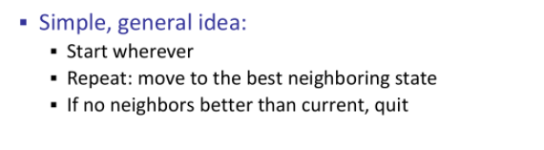
Hill climbing

Slide 8
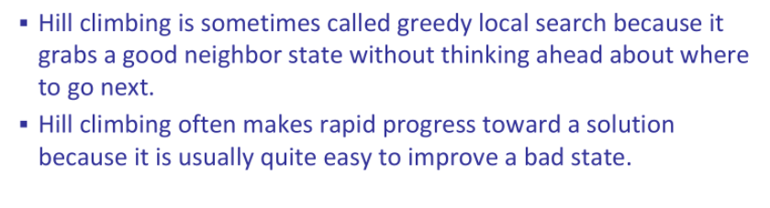
Hill climbing

Slide 9
Hill-climbing search
It is a local search algorithm having knowledge of local domain.
It is simply a loop that continually moves in the direction of increasing value—that is, uphill. It terminates when it reaches a “peak” where no neighbor has a higher value.
If neighbor state (New evaluated state) is better than current state then make it is a new state.

Slide 10
Hill-climbing search
Hill climbing does not look ahead beyond the immediate neighbors of the current state.
The algorithm does not maintain a search tree, so the data structure for the current node need only record the state and the value of the objective function.
Objective function is to maximize Elevation (fitness value) if your climbing on hill.

Slide 11
Hill-climbing search
Greedy algorithms often perform quite well and Hill climbing often makes rapid progress toward a solution.
No backtracking possible.
However, hill climbing often gets stuck for the following reasons:
Local Maxima
Plateau /flat area

Slide 12
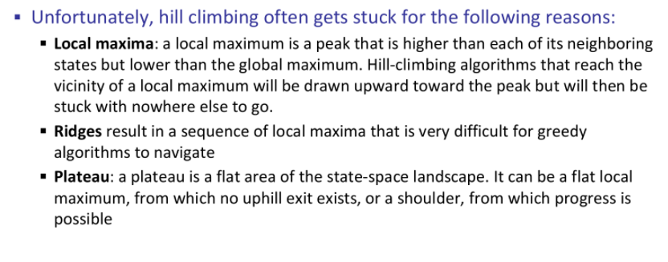
Hill-climbing search

Slide 13
